Slide 1

Identity Management System using Blockchain
Akshay Joshi | 237 | 01FE20BCS102
Kartik Kalal | 251 | 01FE20BCS116
Dhiraj Bhandare | 252 | 01FE20BCS117
Vaishnavi Patil | 258 | 01FE20BCS196
Under the guidance of,
Dr. Narayan D G
Mrs. Manjula Pawar
KLE Technological University, Hubballi

Slide 2
Contents
Introduction
Motivation
Problem Statement and Objectives
System Model
Working of the proposed application
Features of the proposed application
Use case diagram
Results
Conclusion

Slide 3
Introduction
Blockchain is a method of recording information that makes it impossible or difficult for the system to be changed, hacked, or manipulated
Identity management ensures that individuals accessing a system or network are properly authenticated and authorized to access the resources they need.
By establishing and maintaining a unique digital identity for each user, identity management systems can help organizations improve security by preventing unauthorized access and protecting sensitive data.
In our proposed work we have implemented an identity management system in which a user can create an account, provide, and revoke access of documents from various institutions.

Slide 4
Motivation
Effective identity and access management (IAM) is crucial for organizations to safeguard their sensitive resources and data from unauthorized access.
Traditional IAM solutions have limitations, such as centralized control and a lack of transparency, that can lead to security breaches.
Blockchain technology offers a solution to these challenges by providing a decentralized and tamper-proof ledger that can be used to securely manage digital identities.

Slide 5
Problem Statement
To develop a secure, efficient and reliable Identity Management System using Blockchain.
Objectives
To set up a blockchain network using the Ethereum platform.
To develop an efficient and secure system for storing and retrieving digital identities.
To facilitate easy sharing of data.
To provide user-friendly interface.
To provide access control to the owners.

Slide 6
Methodology

Slide 7
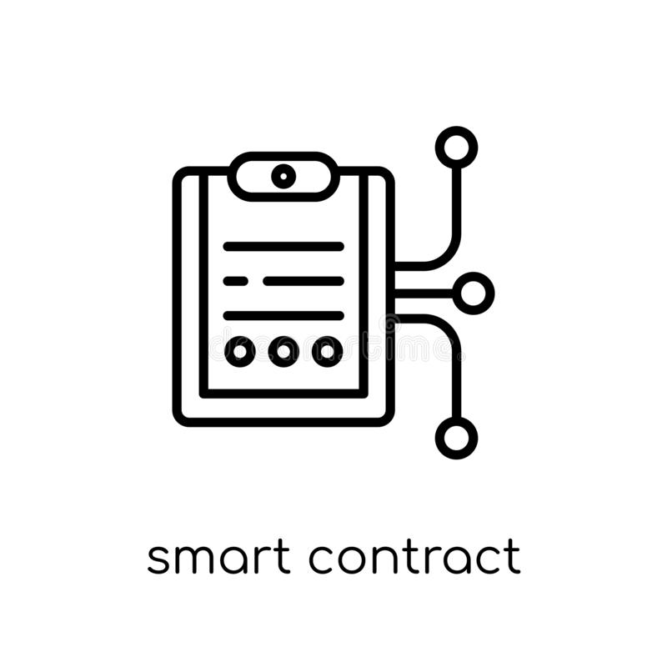

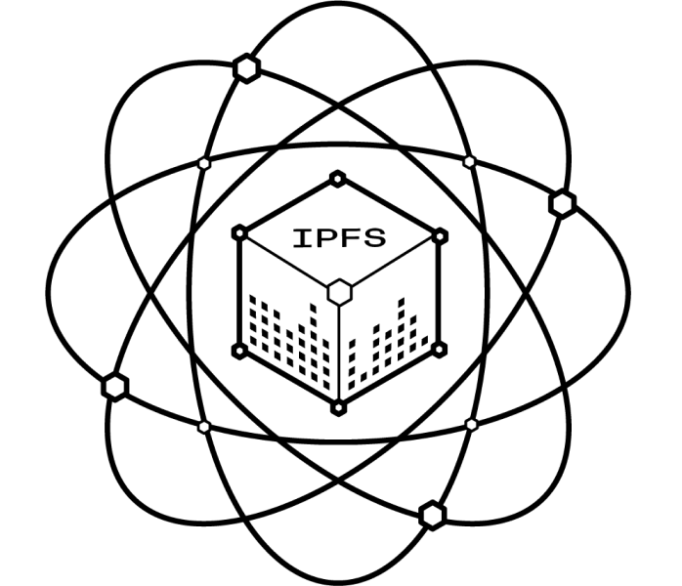

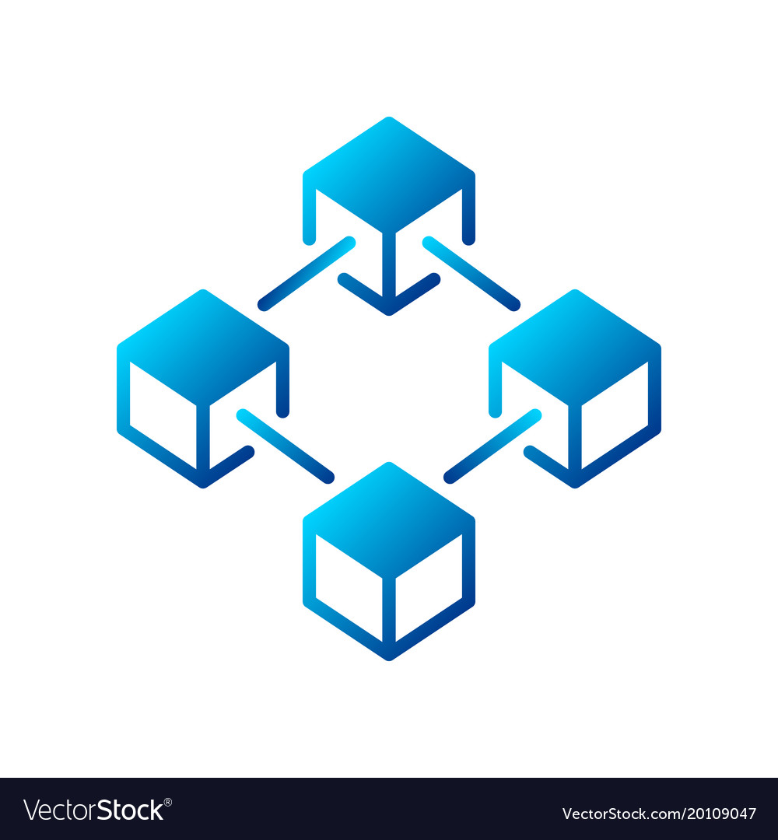
Documents stored in IPFS
Retrieve docs from IPFS
Display docs and details
View/upload
System Model
docs?
Transaction recorded
Upload docs to IPFS
Display details of access given
List access
given?
If new user?
No
Connect wallet
If proper credentials?
Home page
View organization?
Display organization details
Back
Yes
User
Yes
No
Register user details
Display details of access received
List access received?
Redirect to
Transaction recorded
Smart Contract
Blockchain
Perform grant/revoke access
Grant/Revoke access?
Redirect to
Transaction recorded

Slide 8
Working
Step 1: Create user/organization account.
Step 2: Login to the application.
Step 3: Upload documents such as Aadhar, PAN card or Driving License.
Step 4: View all uploaded documents.
Step 5: View the list of all genuine organizations.
Step 6: Grant or revoke access to other users/organizations.
Step 7: View the details of documents shared to other users.
Step 8: Organization can view the documents of other users, provided it has access privilege.
Step 9: User revokes access from the organization.

Slide 9
Features of the proposed application
User shall be able to create an account.
User shall be able to login to his/her account.
User shall be able to upload documents such as Aadhar, PAN card and Driving License.
User shall be able to view all uploaded documents.
User shall be able to view the list of all genuine organizations that he can share his identity with.
User shall be able to grant or revoke access to other users/organizations.
User shall be able to view the details of document access shared to others.
User shall be able to view the documents of other users, provided he has access privilege.

Slide 10
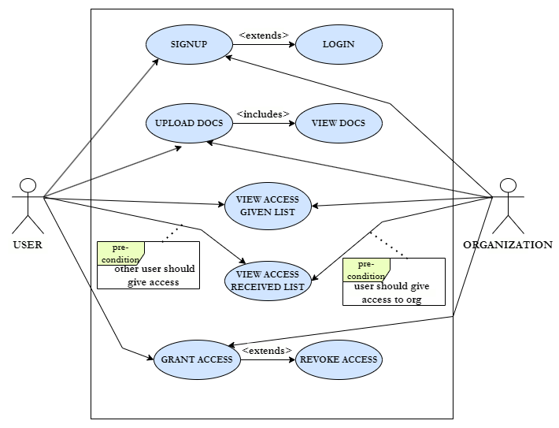
Use case diagram

Slide 11
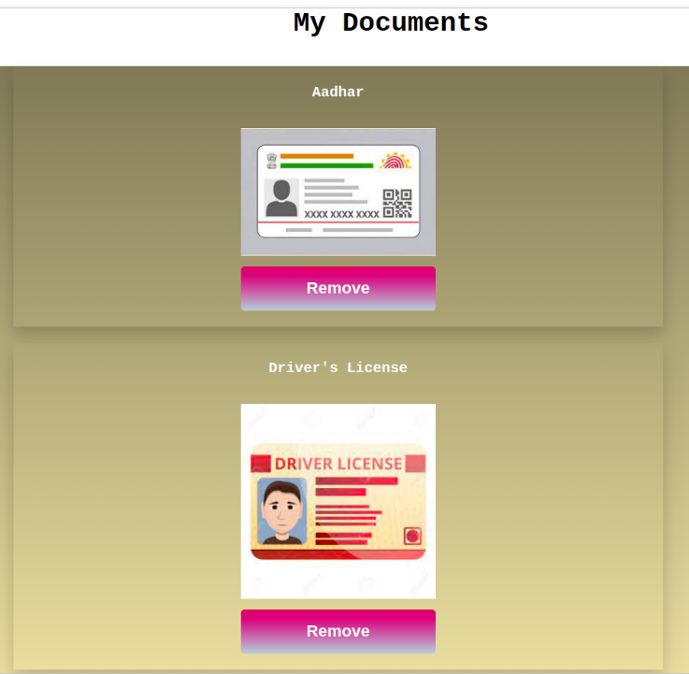
Results
Fig i. Uploaded documents

Slide 12
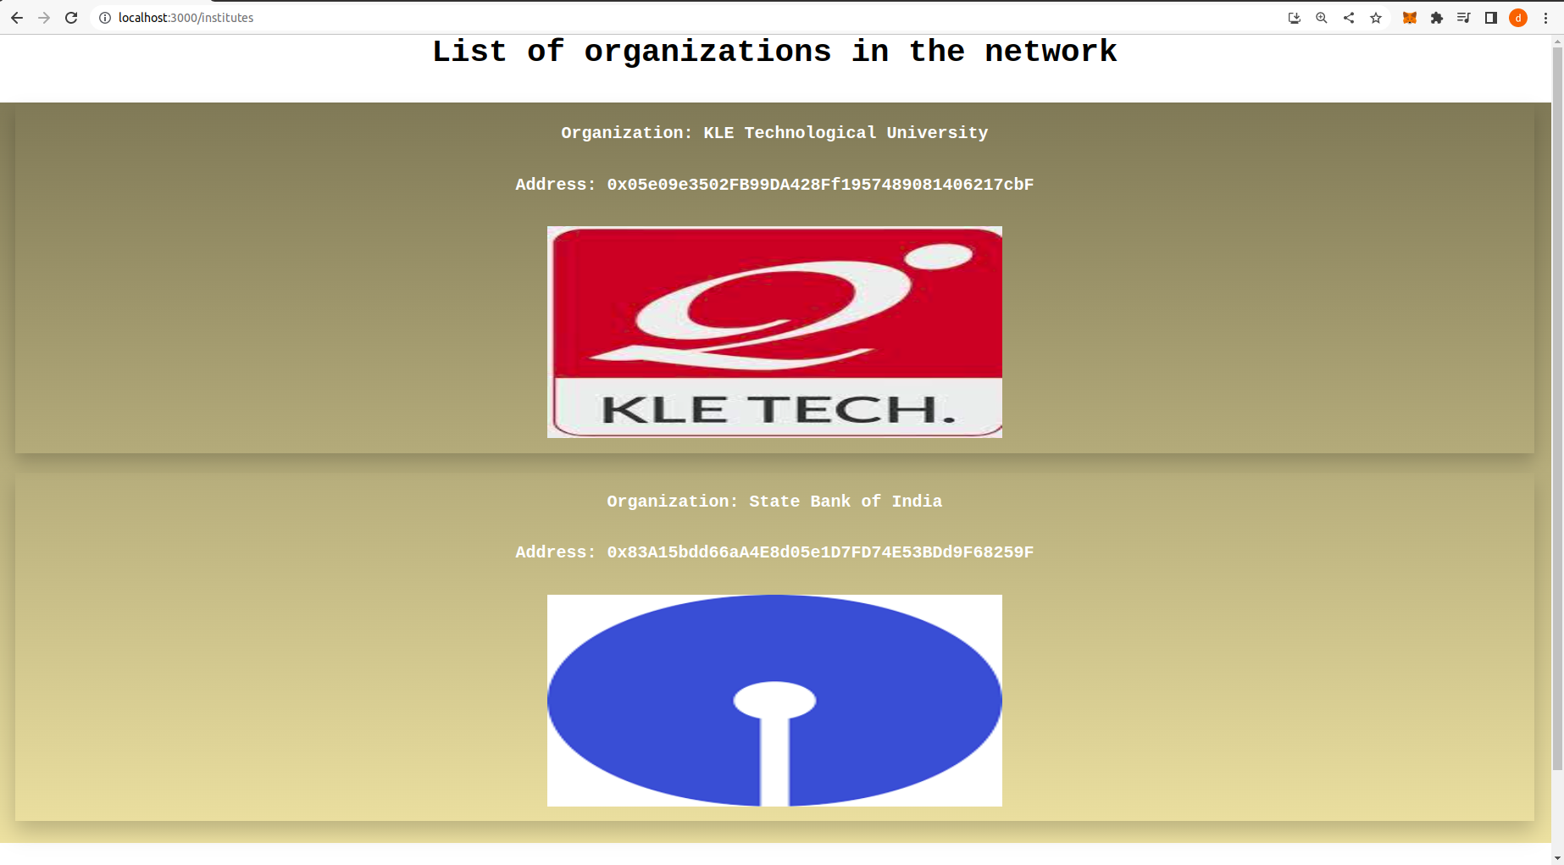
Results
Fig ii. List of organizations in the network

Slide 13
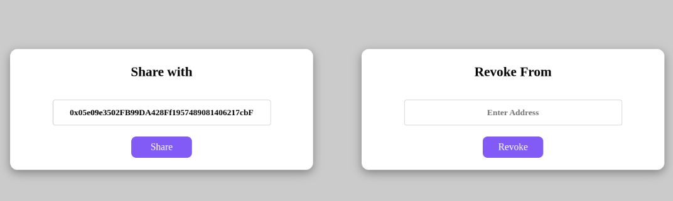
Results
Fig iii. Access control

Slide 14
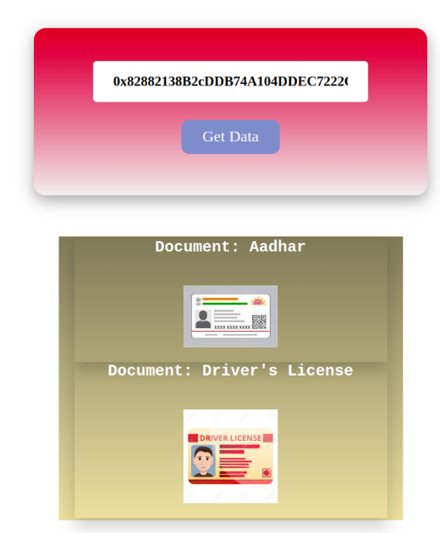
Results
Fig iv. View documents

Slide 15
Conclusion
In conclusion, the implementation of an identity management system using blockchain technology offers numerous advantages and has the potential to revolutionize the way we manage and protect our identities.
By leveraging the decentralized and immutable nature of blockchain, this application provides a secure and transparent framework for identity verification and authentication.
With enhanced security, privacy, user control, efficiency, and transparency, this project has paved the way for a more secure and user-centric digital identity ecosystem.

Slide 16
Thank you

